Slide 1

Sheet Metal Shop
Roll No. | Name |  | Topic
C046 | Chaitanya Ajgoankar | 70322000028 | Introduction to the topic
C047 | Ishwari Birje | 70322000030 | Advancements
C048 | Pratham Vasa | 70322000046 | Applications
C049 | Chahel Gupta | 70322000047 | Applications
C050 | Vivean Arya | 70322000048 | Advancements

Slide 2
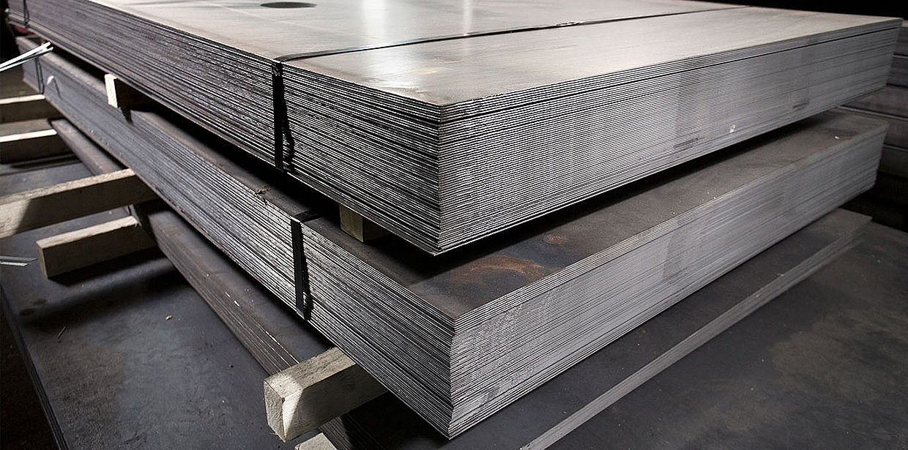
What is Sheet Metal?
Sheet metal is a thin, flat piece of metal formed during an industrial process that is used for many everyday applications.
Metalworkers work more than a dozen types of processes to form sheet metal into usable pieces for these applications
The thickness of the sheet is usually referred to as its gauge, with larger gauge numbers indicating a thinner metal.
Sheet metal is any metal that has a thickness in between 0.5…6 millimetres.
There are other measurement units used to categorise metals by thickness, though.

Slide 3
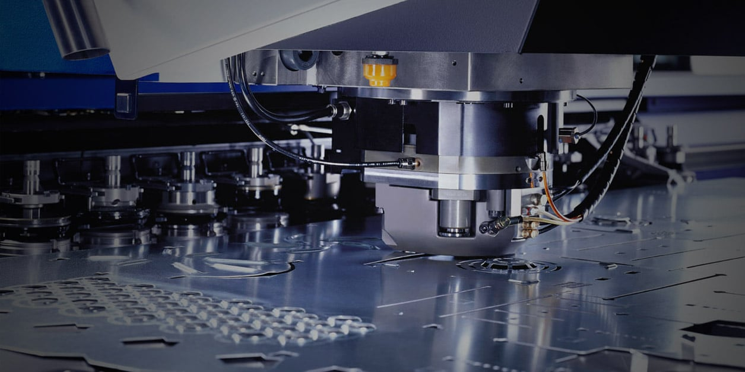
Sheet Metal Shop
SHEET METAL SHOP deals with working of thin sheets with hand tools and simple machines into various cutting forms by:
Cutting
Forming into shapes
Joining
of a variety of thin materials including, steel, stainless steel, copper, brass, aluminum, tantalum, and titanium.

Slide 4
Types of Sheet Metal Fabrication Metals
Sheet metal can come in a wide variety of types, and fabrication can adapt the metal to whatever purposes you may need. Types of common metals used in sheet metal fabrication include:
Steel
Aluminum
Magnesium
Brass
Bronze
Copper

Slide 5
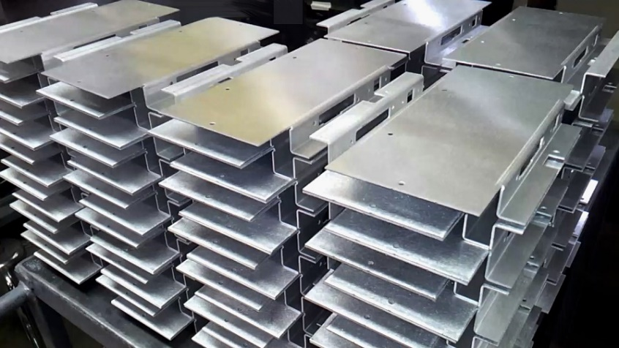
Applications
From microwaves to tractors to cars to forks, sheet metal is a cornerstone of many different things we use everyday.
Sheet metal is metal that has been formed into a sheet that is thin and pliable, but maintains structural integrity and strength (unlike foil).
Sheet metal comes in 4 different forms: cold rolled steel, hot rolled steel, stainless steel and aluminum.
Each of these different categories vary in thickness, hardness, strength and ideal application.

Slide 6
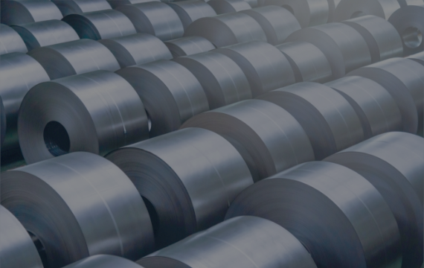
Cold Rolled Steel
WHAT ITS USED FOR:
Has a more finished appearance than hot rolled steel, and works best for anything that needs a polished, even appearance.
Often used in home appliances, metal furniture, filing cabinets and school lockers.
In construction, cold rolled steel is a common material for building steel sheds, industrial buildings and garages.

Slide 7
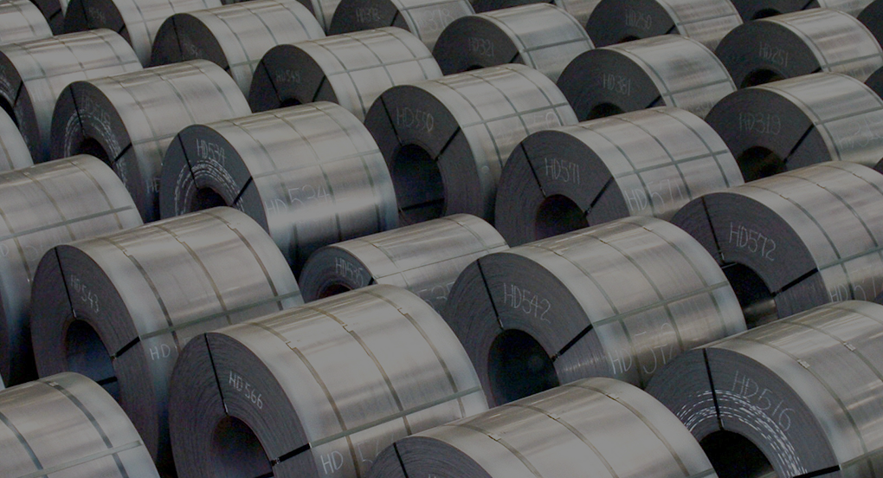
Hot Rolled Steel
WHAT IT’S USED FOR:
Structural components like I beams, cross sections, rail tracks and sheet metal
Commonly used for art sculptures (after stainless steel)
Used for truck frames and auto seat frames
Used widely in agriculture equipment thanks to its strength and flexibility

Slide 8
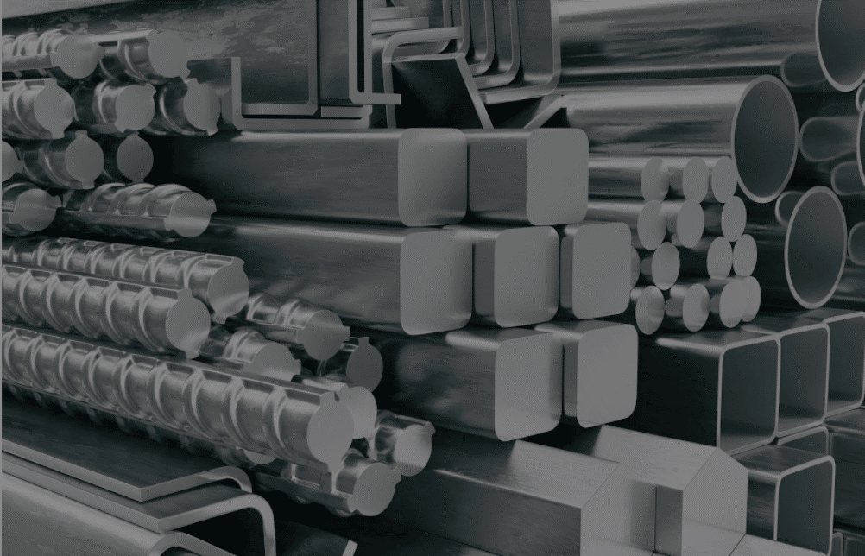
Stainless Steel
WHAT ITS USED FOR:
Commonly used in construction thanks to its strength, flexibility and resistance to corrosion.
Used in car exhaust systems, trim and grills and structural components.
Used in surgical and dental instruments, MRI scanners, surgical implants, and pins and plates used to fix broken bones in place.
Used in kitchen accessories, kitchen appliances, sinks, counters, cutlery and cookware.
Used to make storage tanks, valves, pipes and other components.

Slide 9
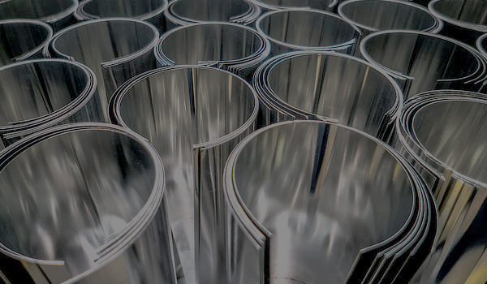
Aluminum
WHAT ITS USED FOR:
Used in transportation — because of its lighter weight, less force is required to move the vehicle
Used to build homes — aluminum need very low maintenance and is thermally efficient, which keeps homes warm in winter and cool in summer (plus it has a smooth finish and can be curved or cut in any shape)
Used in long distance power lines thanks to low density and corrosion-resistance
Used in consumer goods like smartphones, tablets, laptops, and flat screen TVs
Used in motors, appliances, power systems, television antennaes, satellite dishe and LED

Slide 10
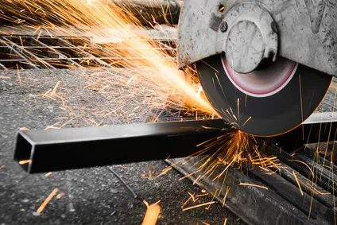
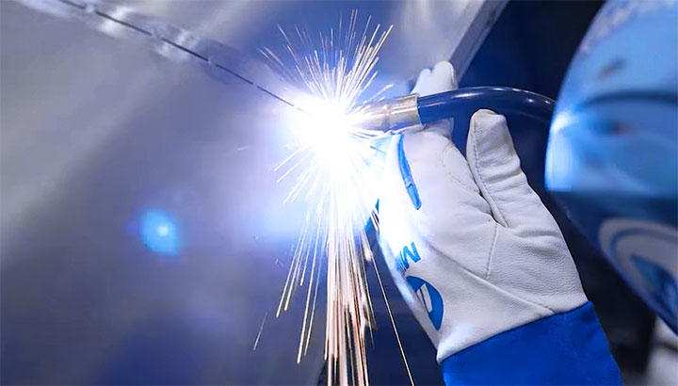
Advancements
Here’s a look at some emerging “hard” technologies that will help us keep improving our metal fabrication efficiency.
1. Cutting
Laser cutting machines are getting faster and can cut thinner sheets with less waste.
That’s down partly to advancements in fiber laser performance and also to improved control technology.
Water jet cutters are getting faster too, as are turret punch machines.
Punch rates are increasing while new and improved cutting tool materials last longer and yield better edge quality.
Plus, EDM lets us make complex tools at lower cost.
2. Welding
Advances in welding are as much about quality as speed.
Improved welding wire coupled with advances in welder control technology benefits both manual and robotic welding.

Slide 11
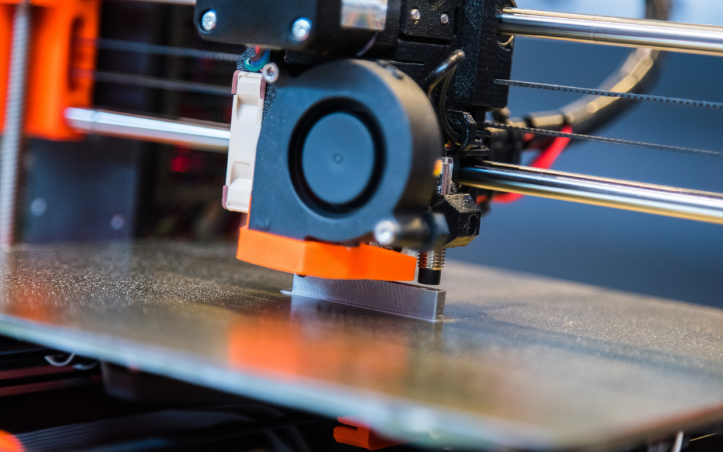
3. Additive manufacturing
You may have seen 3D printers at work – slowly – building nearly finished parts layer-by-layer.
We don’t see additive as taking over from fabrication. It’s too slow and the resulting parts don’t have the right characteristics. But it may change our approach to tooling and fixturing.
Instead of waiting days or weeks for complex custom tools, we could just print them, slashing lead time in the process. The same goes for fixtures to hold assemblies for welding.
By starting with the CAD model we can design and print support pieces in just hours, allowing us to get on with welding without delay.

Slide 12

4. Industry 4.0 / IIoT
“Smart” machines communicating with each other and sending data into the “cloud” for analysis will help improve consistency, but another gain we’re looking for is reduced downtime.
A “smart” machine will know when maintenance is coming due and schedule the work automatically.
That means improved machine availability, allowing us to get more out of our equipment.
5. Materials advances
Graphene (sheets of carbon just a single atom thick,) is getting a lot of attention.
No doubt it has the potential to revolutionize industries from medicine to electronics and energy, but it’s hard to see it being used for parts like those used in truck trailer manufacturing.
The metal fabrication industry has come a long way throughout history.
At one point in time, workers had to do everything by hand. Not only did this take forever, it was also backbreaking work.
Now, fabricators have many tools at their disposal to make their lives easier. Fortunately for them, manufacturers are just getting started.

Slide 13
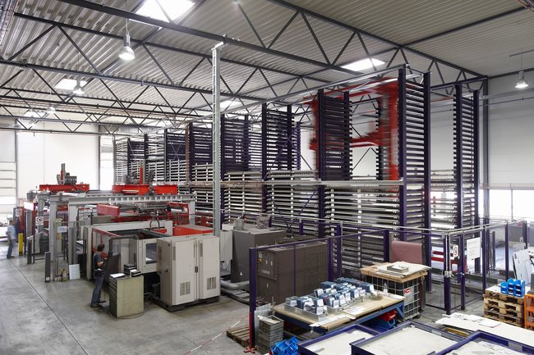
Automated Systems
Perhaps the most significant technology advancement in the metalworking industry is automation.
Before systems were computerized, workers would have to put themselves in dangerous situations to make adjustments.
Yes, metalworking is still an incredibly dangerous job. However, with CNC controls, fabricators can now adjust the computer so they don’t endanger themselves on the floor.
Supervisors should be happiest about these advancements since they prevent accidents on the worksite.
So many industries rely on the services fabricators provide. That’s why machines must always be in working order so everyone gets the products they need

Slide 14

Eco-Friendliness
Like many others in the manufacturing industry, metal fabrication businesses are trying to do their part to reduce their carbon footprint.
Manufacturers are trying to be eco-friendlier by creating machines that use less energy, and as a result, have less impact on the environment.
Machines such as the EVO III press breaks can perform the same number of jobs by using half the energy.
Since everyone should do their part to help keep the Earth clean, supervisors should consider investing in one of these tools.

Slide 15
Bibliography
https://www.thomasnet.com/articles/custom-manufacturing-fabricating/about-sheet-metal-fabrication/
https://engineering.lbl.gov/sheet-metal-shop/
https://www.slideshare.net/manojmama22/sheet-metal-shop
https://fractory.com/sheet-metal/
https://www.quora.com/What-is-sheet-metal
https://www.wileymetal.com/advances-in-technology-drive-higher-metal-fabrication-efficiency/
https://www.mac-tech.com/technology-advancements-in-the-metalworking-industry/
https://cranerepairco.com/blog/applications-require-sheet-metal-fabrication/
https://www.sciencedirect.com/science/article/pii/S2214785317322721

Slide 16

Thank you

